Slide 1
Advanced Section: Variational Inference

Slide 2

Statistical Inference
Draw conclusions about an underlying distribution of probabilities from a sample
Sampling
Population
Sample
Inference

Slide 3
Outline
Bayesian Inference
Markov Chain Monte Carlo
Bayesian Neural Networks
Variational Inference
Drop Out as a Bayesian Approximation
Bootstrap for Inference

Slide 4
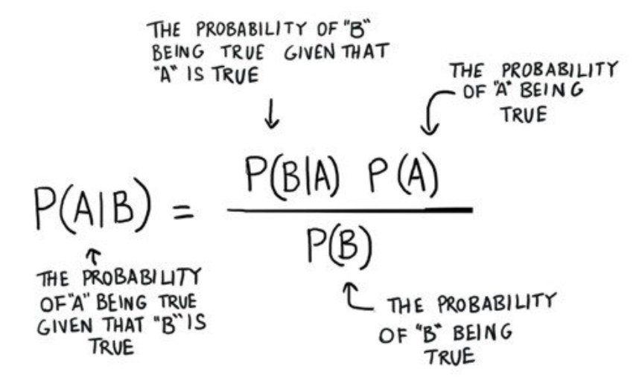

Bayesian Inference
Probability as a measure of believability in an event
$$p(θ|y)∝p(y|θ)p(θ)$$
Model
Data

Slide 5
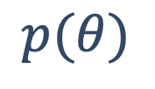
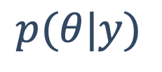
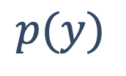
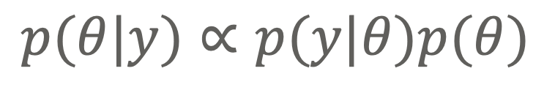
Bayesian Inference
$$p(θ|y)∝p(y|θ)p(θ)$$
$$p(θ|y)$$
$$p(y)$$
$$p(θ)$$
“When the facts change, I change my mind. What do you do, sir? “John Maynard Keynes

Slide 6
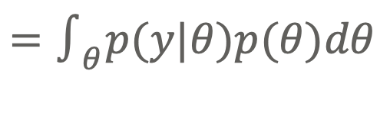
Bayesian Inference
$$p(θ|y)∝p(y|θ)p(θ)$$
$$p(θ|y)$$
Intractable
$$p(y)$$
$$=∫_{θ}p(y|θ)p(θ)dθ$$
$$p(θ)$$
“When the facts change, I change my mind. What do you do, sir? “John Maynard Keynes

Slide 7
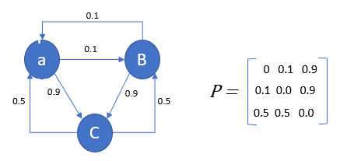
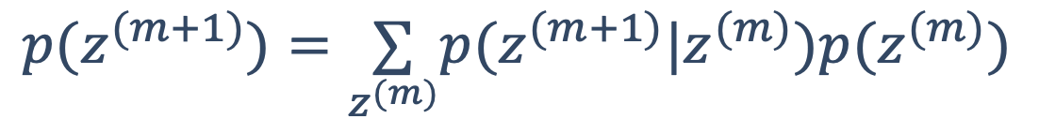
MCMC: Markov Chains
$$p(z^{(m+1)}|z^{(1)},...,z^{(m)})=p(z^{(m+1)}|z^{(m)})$$
$$p(z^{(m+1)})=\underset{z^{(m)}}{∑}p(z^{(m+1)}|z^{(m)})p(z^{(m)})$$

Slide 8
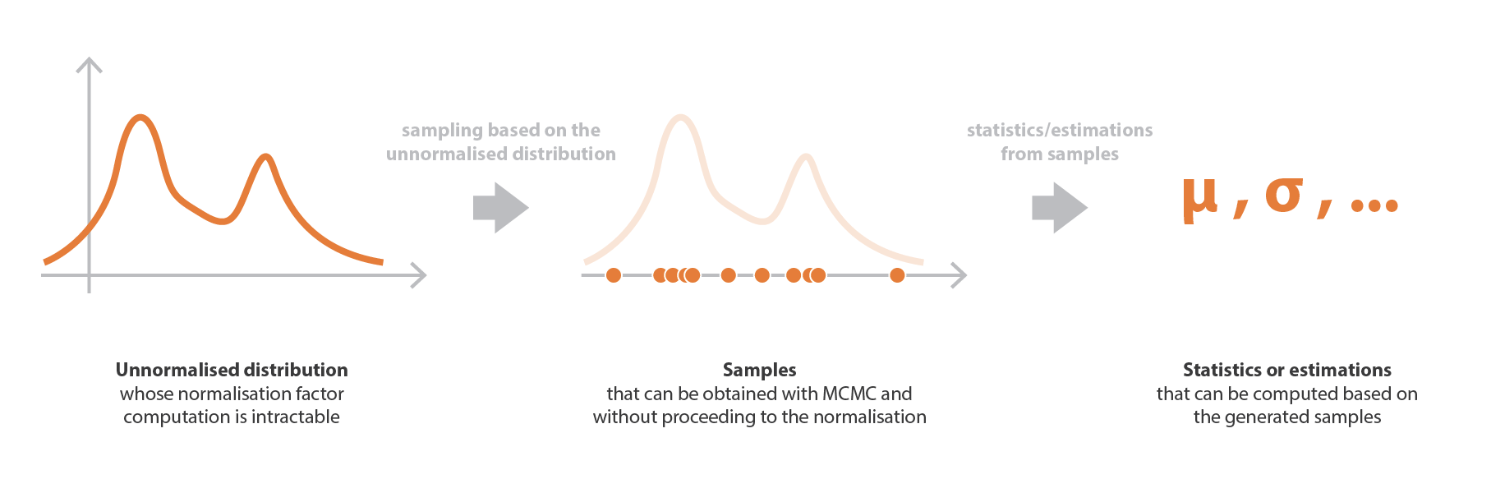
MCMC: Sampling method

Slide 9
MCMC
Credit: Towards Data Science

Slide 10
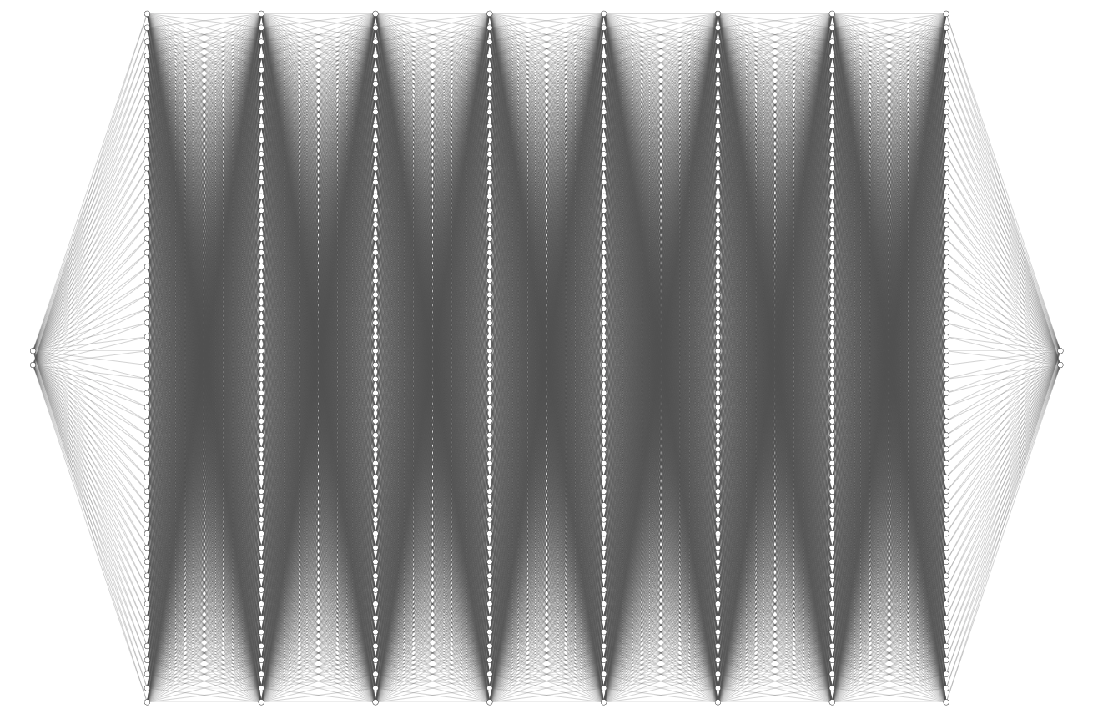
Bayesian Neural Networks: FCNN
Input
Output

Slide 11
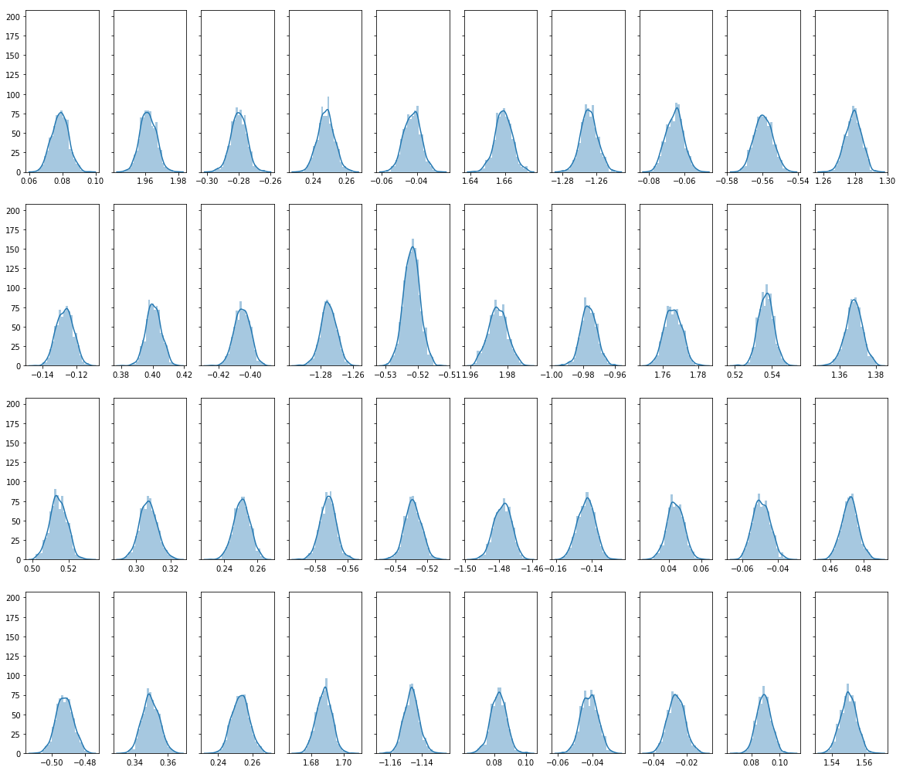
Bayesian Neural Networks: FCNN
Input
Output

Slide 12
Bayesian Neural Networks
Output
Input

Slide 13
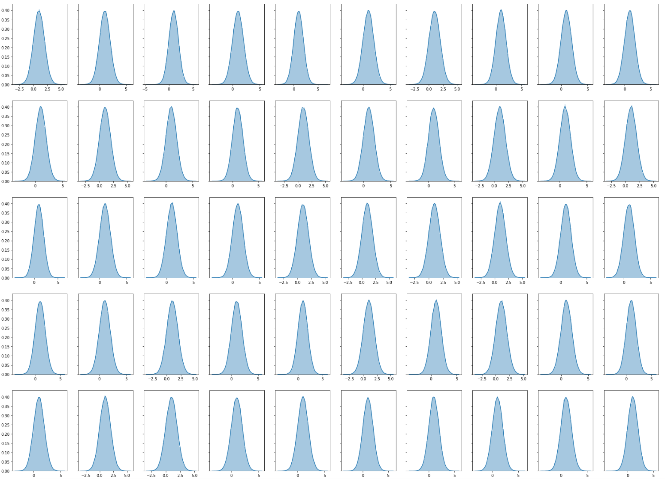


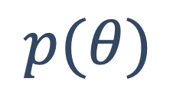
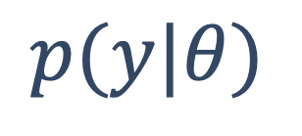
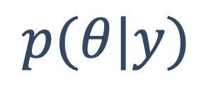

Bayesian Neural Networks
Priors
$$p(θ)$$
$$p(y|θ)$$
$$∝$$
$$p(θ|y)$$
$$×$$
Means
FCNN
& Scale

Slide 14
MCMC is eventually accurate, but not scalable to large models
Bayesian Neural Networks
$$p(θ)$$
$$p(y|θ)$$
$$∝$$
$$p(θ|y)$$
$$×$$
Approximate Bayesian Inference: Variational Inference

Slide 15
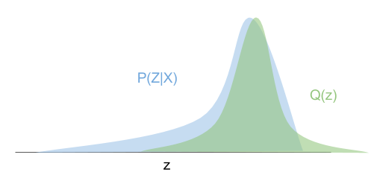
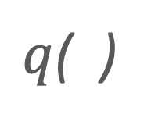
Variational Inference
Optimization approach -> Q a family of “nice” distributions
$q$( )

Slide 16
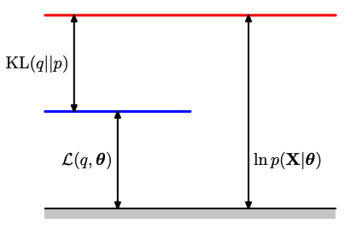
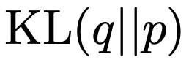
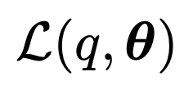
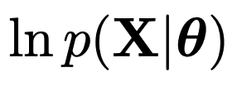

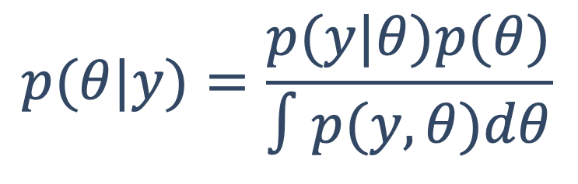
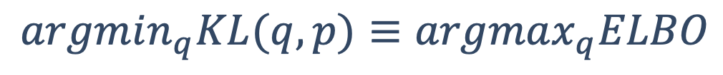

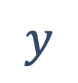
Variational Inference
$$p(θ|y)=\frac{p(y|θ)p(θ)}{∫p(y,θ)dθ}$$
Kullback-Leibler divergence:
$$p(θ|y)≈q∗=argmin_{q∈Q}f(q(θ),p(θ|y))$$
$$argmin_{q}KL(q,p)≡argmax_{q}ELBO$$
$$y$$
$$θ|y$$
$$θ|y$$
Bishop

Slide 17
Variational Inference
Output
Input

Slide 18
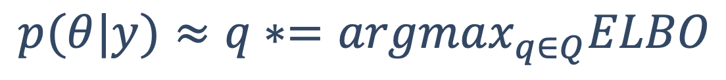
Variational Inference
$$p(θ|y)≈q∗=argmax_{q∈Q}ELBO$$
Output
Input

Slide 19
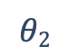
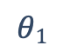
Variational Inference
$$θ2$$
Exact
VI
$$θ1$$
Underestimates variance (sometimes severely)

Slide 20
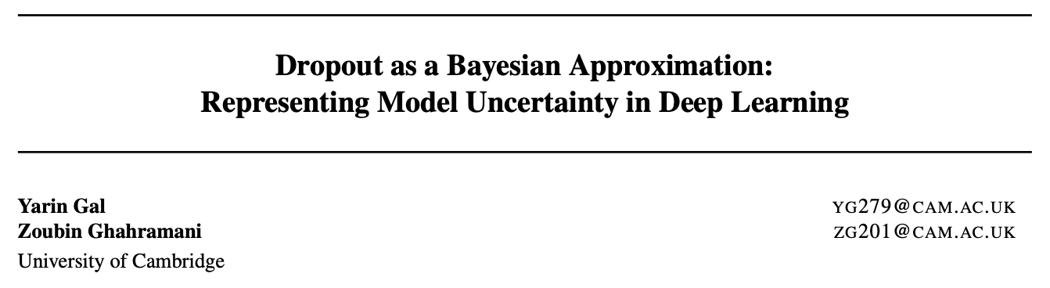
Dropout
arXiv:1506.02142

Slide 21
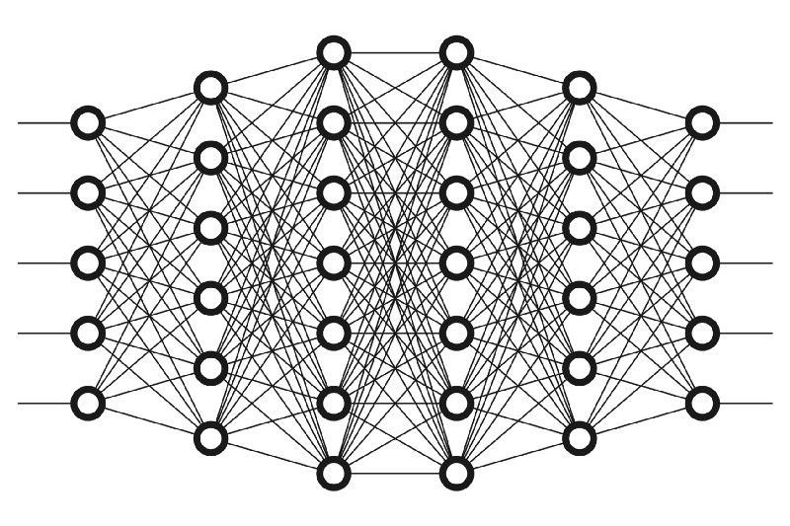

Dropout: train
Forward Pass
Back Propagate
Radu Raicea

Slide 22
Dropout: train
Forward Pass
Back Propagate
Radu Raicea

Slide 23
Dropout: train
Forward Pass
Back Propagate
Radu Raicea

Slide 24
Dropout: train
Forward Pass
Back Propagate
Radu Raicea

Slide 25

Dropout: evaluate
Forward Pass
Radu Raicea

Slide 26
Dropout: evaluate
Forward Pass
Radu Raicea

Slide 27
Dropout: evaluate
Forward Pass
Radu Raicea

Slide 28
Dropout: evaluate
Forward Pass
Radu Raicea

Slide 29
Dropout: evaluate
Forward Pass
Radu Raicea

Slide 30
Bootstrap for Inference
Input
…

Slide 31
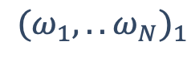
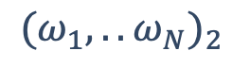
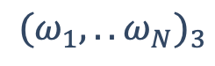
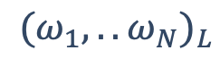
Bootstrap for Inference
$$(ω_{1},..ω_{N})_{1}$$
$$(ω_{1},..ω_{N})_{2}$$
Input
$$(ω_{1},..ω_{N})_{3}$$
…
…
$$(ω_{1},..ω_{N})_{L}$$

Slide 32
Bootstrap for Inference
$$(ω_{1},..ω_{N})_{1}$$
Output1
$$(ω_{1},..ω_{N})_{2}$$
Output2
$$(ω_{1},..ω_{N})_{3}$$
Output3
Input
…
…
…
$$(ω_{1},..ω_{N})_{L}$$
OutputL

Slide 33

Bootstrap for Inference
$$(ω_{1},..ω_{N})_{1}$$
Output1
Statistics
$$(ω_{1},..ω_{N})_{2}$$
Output2
$$(ω_{1},..ω_{N})_{3}$$
Output3
Input
…
…
…
$$(ω_{1},..ω_{N})_{L}$$
OutputL

Slide 34
Bootstrap for Inference
Priors in initializing
$$(ω_{1},..ω_{N})_{1}$$
Output1
Statistics
$$(ω_{1},..ω_{N})_{2}$$
Output2
$$(ω_{1},..ω_{N})_{3}$$
Output3
Input
…
…
…
$$(ω_{1},..ω_{N})_{L}$$
OutputL

Slide 35

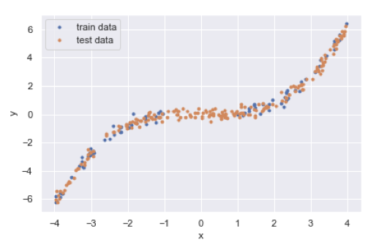
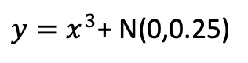
Working Example
$y=x^{3}$+ N(0,0.25)

Slide 36

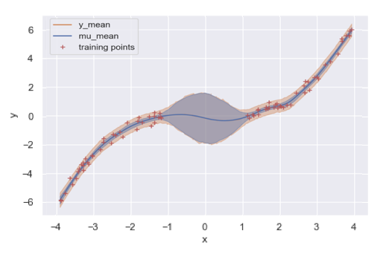
Working Example

Slide 37

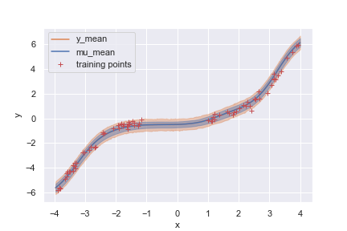
Working Example

Slide 38

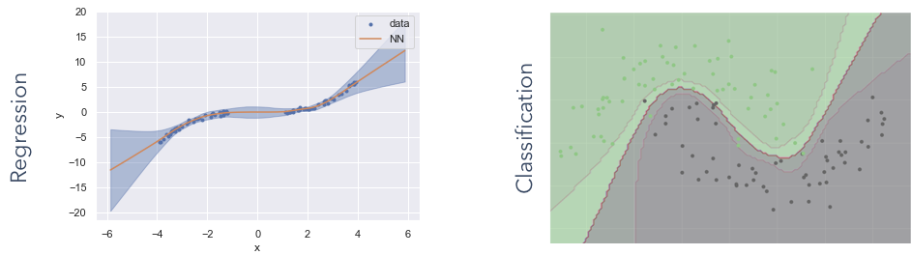
Working Example

Slide 39
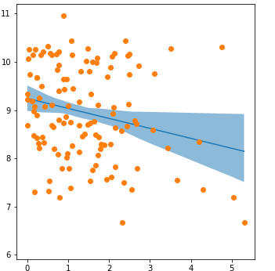
Working Example

Slide 40
Extra

Slide 41
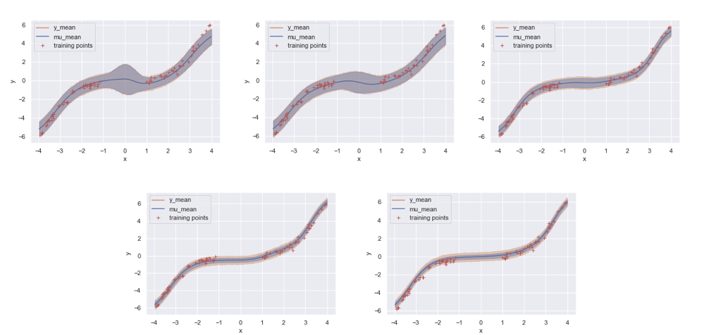
Working Example

Slide 42
DONE

